Slide 1
Check out the Moving Forward with High School Redesign Wiki:
www.abhsredesign.ca
WIFI Password: ???
http://highschoolredesign.weebly.com/watch.html

Slide 2
Road to Redesign!
South Regional Redesign
Network Meeting
St. Mary’s University, Calgary Alberta
January 27, 2014

Slide 3
Welcome and We Heard You!
Today is about ….
School teams working together to deepen understanding about this work
More opportunities for strategy sharing from schools who have lived this work
Developing and sharing tools to measure and evaluate further progress in the project
Notes:
Welcome
Guiding people in to get them thinking about the self-reflection on page one of planning tool
School teams need time to work together discussing/ planning based on the information that is presented during the day
More conversation time within and between schools to fully flush out key ideas
Time to discuss/ create tangible tools and measures to help evaluate and further the progress of the project
We Heard You!
(Today is also setting up for April 15)
Wiki space overview
Share agenda and walk through planning tool

Slide 4
Agenda
9:00 Welcome and We Heard You!
Agenda
On-line Community
Planning Tool
9:15 Student Voice – ’10 Expectations’
9:30 to 10:30 Road to Redesign! The Tale of Three Schools
10:45 to 11:45 Backwards Design
11:45 to 12:00 Shifts in Practice – Using Data to Guide Planning
12:00 to 12:45 Lunch
12:45 to 1:00 Recap of the morning
1:00 to 2:15 Working through School Plans -Where are you in the process?
School Team Discussion and Planning
Central Office Discussion and Planning
2:15 to 2:30 Group Sharing
2:30 – 2:45 Closure/Evaluation/Next Meeting April 10th Olds College

Slide 5
Wikispace Overview
Moving Forward with High School Redesign
www.abhsredesign.ca
Notes:
Welcome
Guiding people in to get them thinking about the self-reflection on page one of planning tool
School teams need time to work together discussing/ planning based on the information that is presented during the day
More conversation time within and between schools to fully flush out key ideas
Time to discuss/ create tangible tools and measures to help evaluate and further the progress of the project
We Heard You!
(Today is also setting up for April 15)
Wiki space overview
Share agenda and walk through planning tool

Slide 6
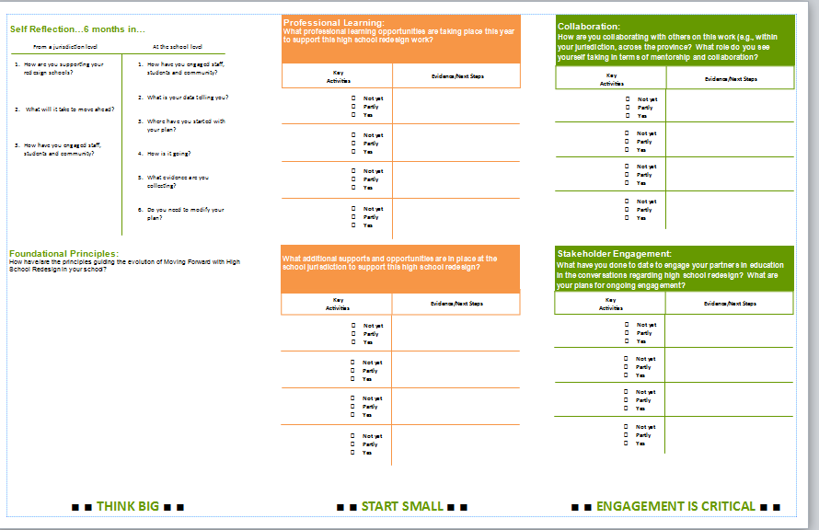
A Walk Through the Planning Tool
Notes:
Welcome
Guiding people in to get them thinking about the self-reflection on page one of planning tool
School teams need time to work together discussing/ planning based on the information that is presented during the day
More conversation time within and between schools to fully flush out key ideas
Time to discuss/ create tangible tools and measures to help evaluate and further the progress of the project
We Heard You!
(Today is also setting up for April 15)
Wiki space overview
Share agenda and walk through planning tool

Slide 7
Notes:
Getting Started
Student Voice Video Clip – 10 Expectations
Example question: Does your school adequately meet the needs of all students? If so, how do you know? If not, how can you improve?
It is important that FNMI information is embedded into the day so teams will view high school redesign as one means of helping to eliminate the achievement gap. Interaction with whole group

Slide 8
Road to Redesign! The Tale of Three Schools
Notes:
Individuals share for a few minutes their perspective; then turn over to question/answer process.
Questions from the participants will be shared ahead of time with the panelist (email was sent ahead of time to get brainstorming going)
Include one or two FNMI -specific questions

Slide 9
How is ‘change’ going at your school?
Where is your school in the change process?
How is it working? Do you have engagement of staff? Students? Community?
How have you shifted you practice to improve HS completion?
What happens when the community/ teachers is (are) not engaged?
How are your empowering your staff to have a voice in the process of change?
What do you see happening at your school that makes you excited? Makes you cringe?
What are some relevant data sources to shape high school redesign?
Notes:
Shifts in practice/reflect on Foundational Principles
Allowing groups to work together based on essential questions (What questions would we like to consider?)
Where is your school in the change process?
How is it working? Do you have engagement of staff? Students? Community?
How have you shifted you practice to improve HS completion for your FNMI students?
What happens when the community/ teachers is (are) not engaged?
How are your empowering your staff including FNMI liaisons, coordinators and educators to have a voice in the process of change?
What do you see happening at your school that makes you excited? Makes you cringe?
What are some relevant data sources to shape high school redesign?

Slide 10
Using Data to Guide Planning
Teacher records of:
Attendance/Lates
On-task behaviour
Contributions to discussion
Listening behaviours
Competency development
Other?
Participation rates in:
School programs
Extra-curricular activities
Parent teacher conferences
School/community events
Other?
Surveys:
TTFM
APORI
School generated
Performance measures:
Trend data
Course completions (dual credit, etc)
Other?
Notes:
Sandra/Margaretha’s data source inventory
Looking at your data!
Set the tone for the afternoon (include a statement about FNMI data and using it to inform planning)
Address: what to look at
Provincial, local and anecdotal Triangulation of data
Now that we have it, what do we do with it?
Using student data wall, looking at the hard data…and having the hard conversations about student success
Is it good for students?
Who is not making it? Who are our students not completing?

Slide 11
Morning Recap

Slide 12
This is your time! What is your commitment for your school in the next few months? Who does why by when? By 2:00 pm, complete: “I/we commit to…”
Notes:
This is your time! Working through your School Plans
Break into school/jurisdiction groups to look at your school plan together (Jurisdiction/School)
Essential Question: What is your commitment for your school in the next few months? Who does what by when?
At the jurisdiction level
1. How are you supporting your redesign schools?
2. What will it take to move ahead?
3. How have you engaged staff, students and community, including FNMI parents, Elders, cultural advisors and students in the decision-making process?
How are you using your FNMI data to inform practice in your district?
At the school level
How have you engaged staff, students and community including how you are engaging FNMI parents, Elders, cultural advisors and students in the decision-making process?
What is your data telling you?
Where have you started with your plan?
How are you using your FNMI data to inform practice in your schools?
How is it going?
What evidence are you collecting?
Do you need to modify your plan?
At 2:00…provide cards for everyone to write a commit to statement…”I /we will commit to…”
What did you hear, what will you now do?
Guiding Questions:
Questions from the agenda with the school plan questions. Tri-fold document.
School Team Time
Tools/Resources
Reflect on your plan
Work through your next steps
Report Back to the whole group
Share one thing you discussed that will move your work forward.

Slide 13
Report Back
What will you commit to sharing back by March 1, 2014 via wiki space?
What’s the one big idea you take back to your school?

Slide 14
Telling your school’s story
Engaged students | High levels of achievement | Quality teaching
Identify successes | Identify successes | Identify successes
Identify unanticipated learnings | Identify unanticipated learnings | Identify unanticipated learnings
Next steps | Next steps | Next steps
Notes:
The parking lot will be used to post your thoughts and ideas
Turn over to Nathan and Melanie

Slide 15
Next Steps
Continue the conversation at the school level
Closure and wrap-up
Final Meeting – April 10
Evaluation
Notes:
Closure/Wrap-up/Evaluation
How do we continue this conversation at the school/community level?
Next Steps…Thinking about April 15th…what do we want this to look like not that our thinking is fresh?

